Slide 1

Python
Hands-on jupyter notebook: link.
Pranali Bose

Slide 2
Agenda
Python (with mini challenges)
Fundamentals (variables, numbers, strings, boolean)
Control Flow (if..else, for loop)
Other important concepts (random numbers, lists, dictionaries)
MCQs
Hands-on Exercises
‘I am out’ game
Fun Days
Fortune Number Generator
Paragraph Analyzer
Trip Planner
Print Pi (Home Work)
Trick: Jupyter Themes
Question/Answer

Slide 3
What is Python?
Python is a simple, general purpose, high level, and object-oriented programming language.
Python is an interpreted scripting language also.
Guido Van Rossum is known as the founder of Python programming.

Slide 4
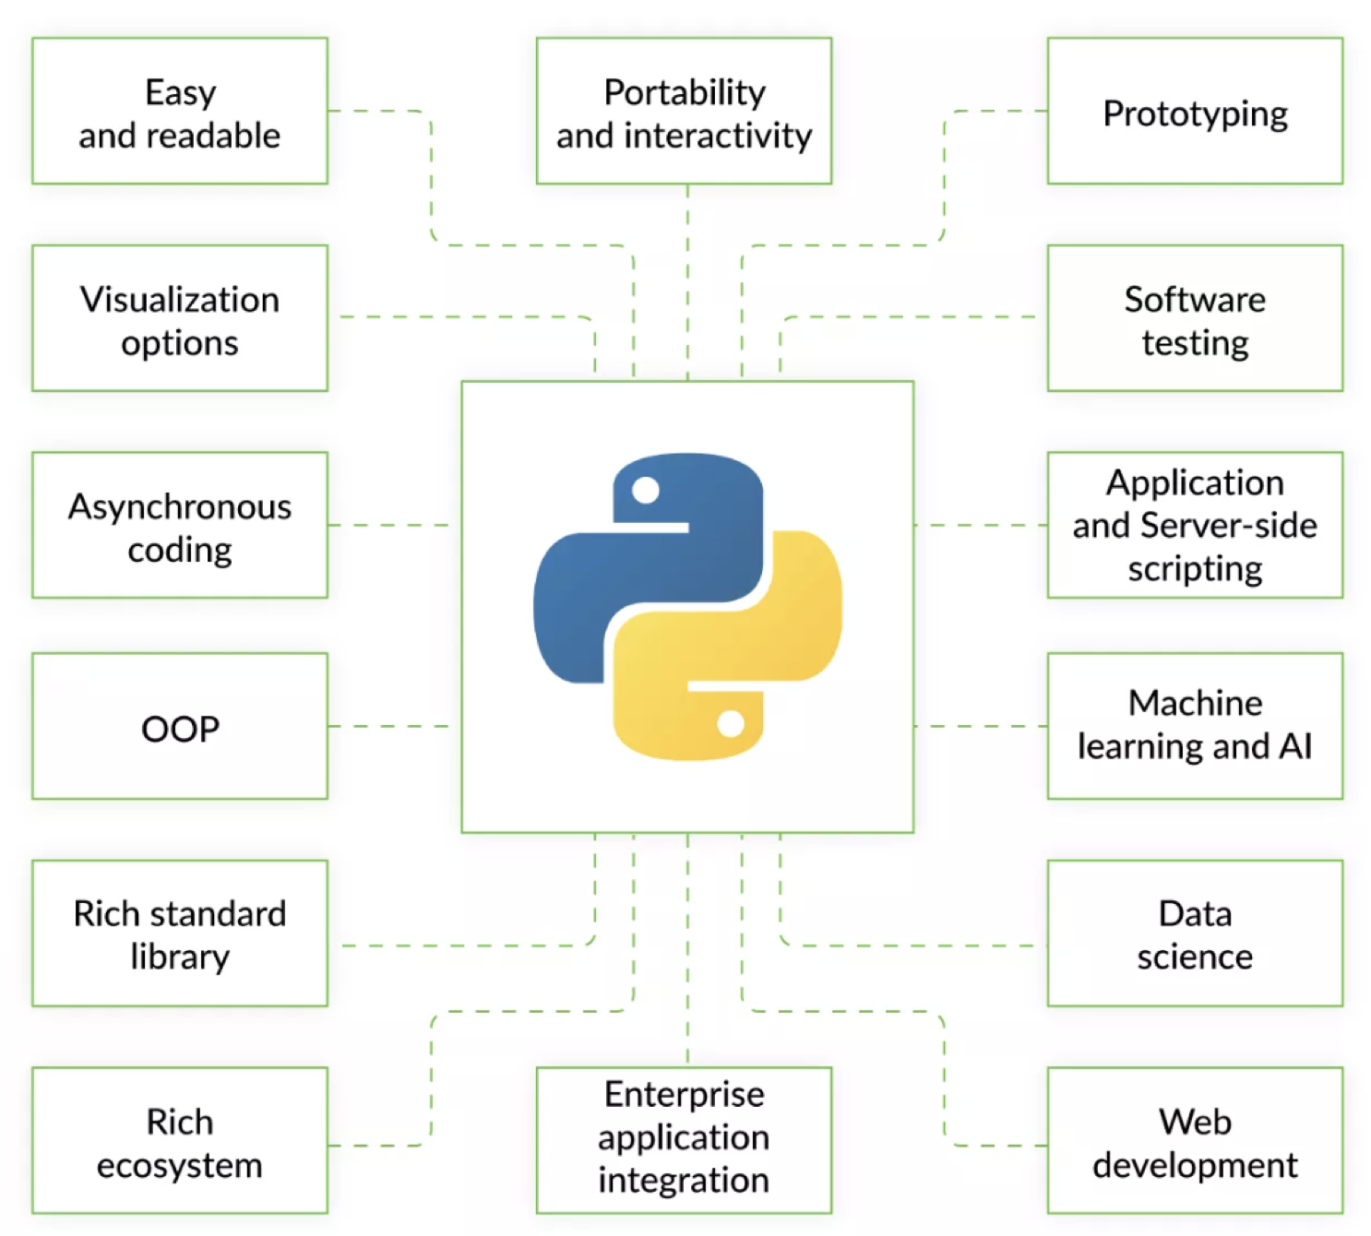

Slide 5
MCQs
What will be the output of 24//12?
2.0
2
24//12
Error

Slide 6
MCQs
String function to add multiple elements to an existing list:
Add
Append
Update
Extend

Slide 7
MCQs
What will be the output?
x = {1: 'X', 2: 'Y’}
del x
The del method does not exist for dictionary
The del will delete the values in the dictionary
The del will delete the entire dictionary
The del will delete all the keys in the dictionary

Slide 8
MCQs
How to convert just the first letter of a string to capital?
toupper()
upper()
capitalize()
title()

Slide 9
MCQs
Output of print(True and (True or False) and True)
True
False
0
1

